Slide 1
Algorithms and Data Structures TEB1113/TFB2023 - may 2025
LAB TA: Reeyan afzal

Slide 2

LAB – 10 Searching & sorting

Slide 3
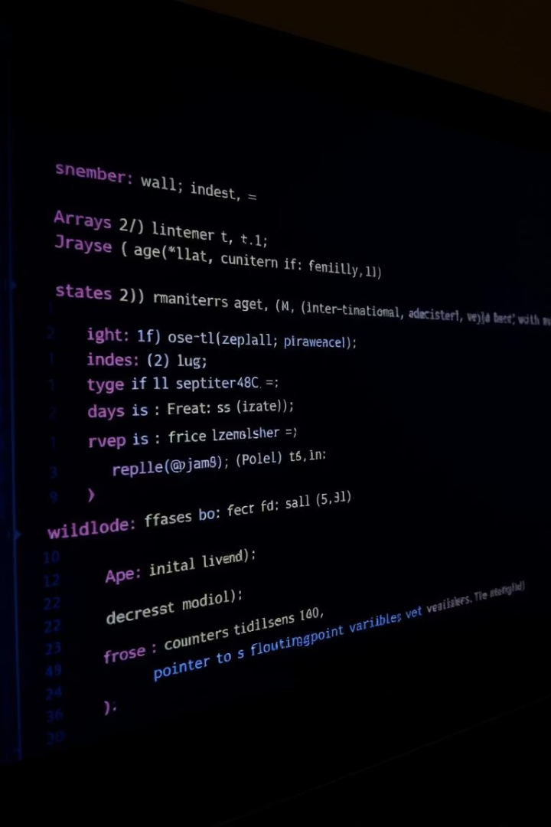
Objectives for lab-10
To search for an element from a list of elements.
To perform sorting using different sorting techniques.
To understand the different searching techniques.
To understand the working of different types of sorting techniques.

Slide 4

Brief history
Searching is the method to retrieve an element or data from any data structure. The searching techniques are broadly classified into:
Linear Search
Binary Search

Slide 5
Linear Search
In Linear search, we try to retrieve an element by checking the array elements in a one-by-one fashion.
It takes 𝑂(𝑛) time to perform the searching operation as it requires the whole array of size 𝑛 to be traversed for checking the elements.

Slide 6
Binary Search
This searching technique requires the array to be sorted before performing the search operation. The sorted array is given as input, which is divided into two subarrays of equal size.
The element is first searched with the middle element of the array, If the element is larger than the middle element, then it will lie in the right subarray; else, search in the left subarray. This step is performed repeatedly until the item is found.
The time complexity for Binary search is 𝑂(𝑙𝑜𝑔 𝑛), where 𝑛 is the size of the array.

Slide 7
sorting
Sorting: Sorting refers to arranging the given data in a specified order. It requires the elements to follow a particular order, e.g., Roll numbers of students are arranged in an ordered way. There are two different categories in sorting. They are:
Internal Sorting: When all data is placed in memory, then sorting is called internal sorting.
External Sorting: When all the data that needs to be sorted cannot be placed in memory at a time, the sorting is called External Sorting. External Sorting is used for the massive amount of data.

Slide 8
Bubble sort
It is a simple comparison-based sorting technique.
In this sorting technique, each element is compared with its adjacent element, and the elements are swapped if it’s not in order.
The time complexity of bubble sort is 𝑂(𝑛2), where n is the size of the array. It is not suitable for large data sizes.

Slide 9
Insertion sort
It is a comparison-based sorting technique where one of the subarrays is always sorted.
For an element to be placed into the sorted subarray, an appropriate place needs to be found to insert the element into the sorted subarray.
The worst-case time complexity for an Insertion sort is 𝑂(𝑛² ).
The number of comparisons in the best case is 𝑂(𝑛) and in the worst case is 𝑂(𝑛²).

Slide 10
Selection sort
Selection sort is a simple sorting algorithm. This sorting algorithm is an in-place comparison-based algorithm in which the list is divided into two parts: the sorted part at the left end and the unsorted part at the right end.
Initially, the sorted part is empty, and the unsorted part is the entire list. The smallest element is selected from the unsorted array and swapped with the leftmost element, and that element becomes a part of the sorted array.
This process continues moving the unsorted array boundary by one element to the right. This algorithm is not suitable for large data sets as its average and worst-case complexities are of 𝑂(𝑛²), where n is the number of items.

Slide 11
Merge sort
It follows the Divide and Conquer approach for sorting an array. In merge sort, an array is first divided into two halves. The two subarrays are then sorted and merged to form the complete sorted array. The sorting of subarrays continues till the number of elements in the subarray reduces to 1.

Slide 12
Quick sort
It follows the Divide and Conquer approach to sort the array. Quick sort is a highly efficient sorting algorithm and is based on the partitioning of an array of data into smaller arrays.
A large array is partitioned into two arrays, one of which holds values smaller than the specified value, say pivot, based on which the partition is made, and another array holds values greater than the pivot value.
Quicksort partitions an array and then calls itself recursively twice to sort the two resulting subarrays. This algorithm is quite efficient for large-sized data sets as its average and worst-case complexities are 𝑂(𝑛²), respectively, and the best-case complexity is 𝑂(𝑛 𝑙𝑜𝑔 𝑛).

Slide 13
heap sort
A heap is a complete binary tree, and a binary tree is a tree in which each node can have the most two children.
Heapsort is a popular and efficient sorting algorithm. Heap sort processes the elements by creating a min-heap or a max-heap using the elements of the given array.
Min-heap or max-heap represents the ordering of an array in which the root element represents the minimum or maximum element of the array.
The concept of heap sort is to eliminate the elements one by one from the heap part of the list and then insert them into the sorted part of the list.
Heapsort is an in-place sorting algorithm. The time complexity of heap sort is 𝑂(𝑛 𝑙𝑜𝑔 𝑛).

